Slide 1
Anatomy of nasal septum
Dr S Jaya Sandeep

Slide 2
Embryology
The primitive septum is initially made entirely of
cartilage.
The superior part ossifies to form the
perpendicular plate of the ethmoid and the vomer in the
poster inferior portion, leaving an antero inferior
quadrilateral cartilaginous plate

Slide 3
Nasal septum
The nasal septum is composed of
Anterior membranous portion
Cartilaginous portion : Quadrilateral cartilage, contribution from upper and lower lateral alar cartilages.
Bony portion : perpendicular plate of ethmoid, vomer and two bony crests of maxilla and palatine.
Quadrilateral cartilage is crucial in development of middle 1/3 of face

Slide 4
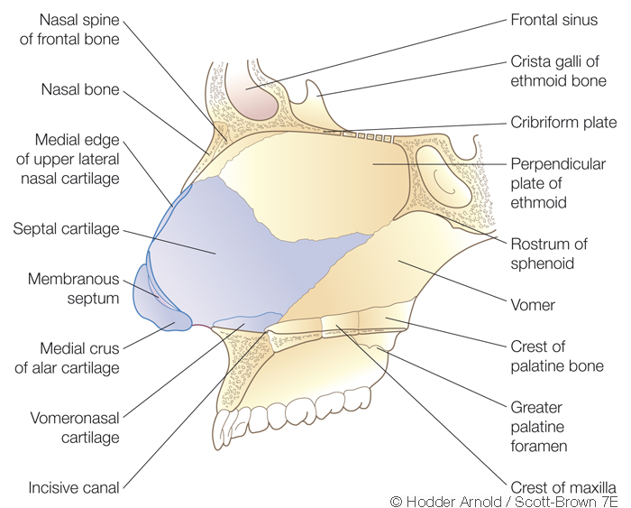

Slide 6
Cartilaginous Portion
3-4mm thick in center and 4-8mm anterior inferiorly – Footplate
Bounded firmly by collagen fibers to bones all around
Sits inferiorly in the nasal crest of palatine process of maxilla
Anteriorly attached by thin membranous septum to medial crura of lower lateral cartilages

Slide 7
Bony portion
The perpendicular plate forms the superior and
anterior bony septum, is continuous above with the
cribriform plate and crista galli.
The vomer
forms the posterior and inferior nasal septum and
articulates by its two alae with the rostrum of the sphenoid.

Slide 8
Vomer bone
Inferiorly – Articulates with nasal crest formed by maxilla and palatine bones
Anteriorly – Articulates with perpendicular plate of ethmoid and quadrilateral cartilage
Posteriorly – Forms free edge of the septum

Slide 9
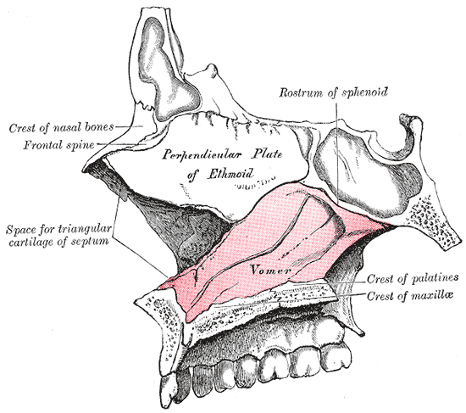

Slide 10
Clinical importance
Deflections may develop at any of the septal articulations
and spurs may also be found where the quadrilateral
cartilage sends small processes between the
ethmoid and vomer.
Such deflections
are far commoner in men than women, they
are most likely to be acquired due to trauma than be
Congenital.

Slide 11
Histology
The
mucous membrane is predominantly respiratory with
a small area of olfactory epithelium superiorly adjacent
to the cribriform plate.
Respiratory epithelium is
composed of ciliated and non-ciliated pseudo stratified
columnar cells, basal pluripotential stem cells and
goblet cells.

Slide 12
histology
Micro villi – Cytoplasmic extensions which increase surface area and prevent drying
Seromucinous glands are present in submucosa and are more important in mucus production in the nasal cavity then the goblet cells which are more numerous in paranasal sinuses.

Slide 13
Blood supply
1) Sphenopalatine artery (Br of maxillary-Br of external carotid)
-Posteroinferior septum
2) Greater palatine artery (Br of Maxillary)
-Anteroinferior portion after entering via
incisive canal
3) Superior labial artery (Br of Facial) –Anteriorly, in particular to Kiesselbach's plexus which is situated in Little's area on the anterior septum – a source of epistaxis
4) Ant and Post Ethmoid Arteries (Br of ICA)-Superiorly, also contributes to Kiesselbach's plexus .

Slide 14
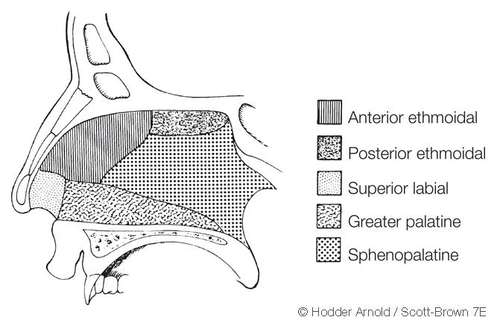

Slide 15
Little’s area
Kisslebacks plexus is formed by
Anterior ethmoidal artery
Septal branch of superior labial artery
Septal branch of sphenopalatine artery
Septal branch of greater palatine artery

Slide 17
Venous drainage
The cavernous venous system drains via the sphenopalatine
vessels into the pterygoid plexus posteriorly
and into the facial veins anteriorly.
Superiorly the
ethmoidal veins communicate with the superior ophthalmic
system and there may be direct intracranial
connections through the foramen caecum into the
superior sagittal sinus.

Slide 18
Nerve supply
The maxillary division of the trigeminal nerve provides
the sensory supply to the majority of the nasal
septum.
The nasopalatine nerve supplies the bulk of
the bony septum, entering the nasal cavity via the
sphenopalatine foramen.

Slide 19
Nerve supply
The anterosuperior part of the septum is supplied
by the anterior ethmoidal branch of the nasociliary
nerve and a smaller anteroinferior portion receives
a branch from the anterior superior alveolar
nerve.
The posteroinferior septum also receives a
small supply from the nerve to the pterygoid canal
and a posterior inferior nasal branch of the anterior
palatine nerve.

Slide 20
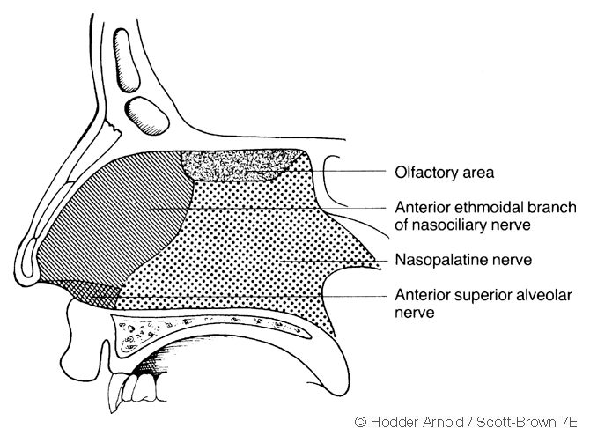

Slide 21
Lymphatic drainage
The anterior septum drains with the external nose to
the submandibular nodes while drainage is to the
retropharyngeal and anterior deep cervical nodes
posteriorly.

Slide 22
Thank you

